Slide 1
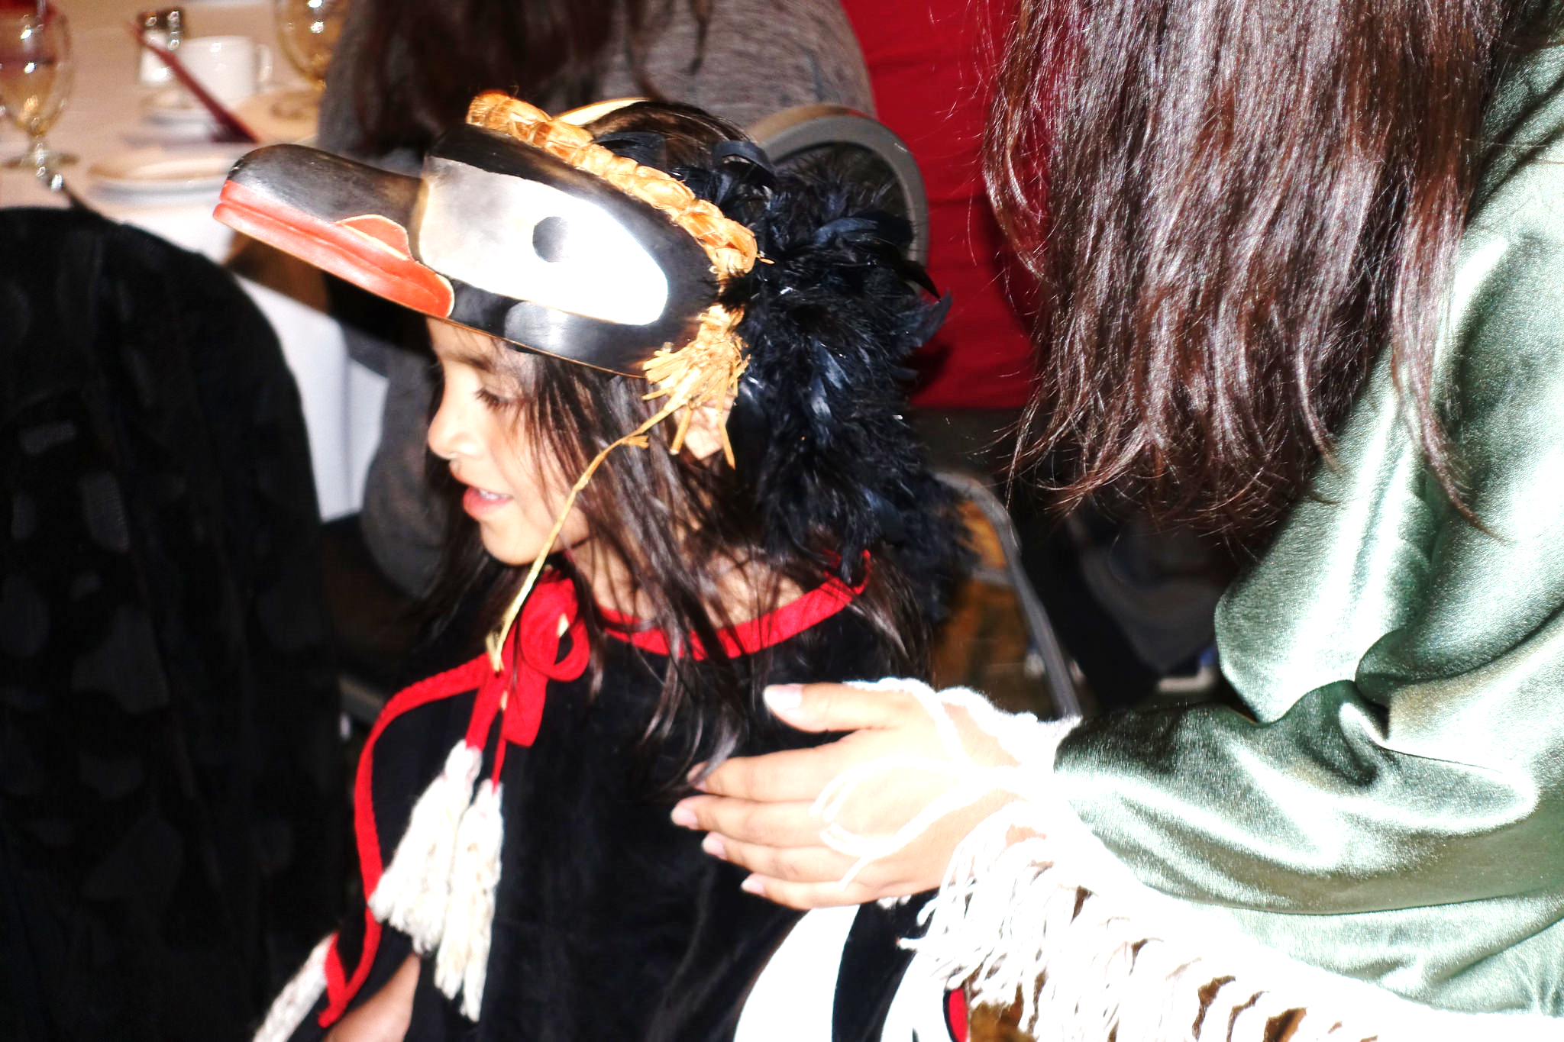
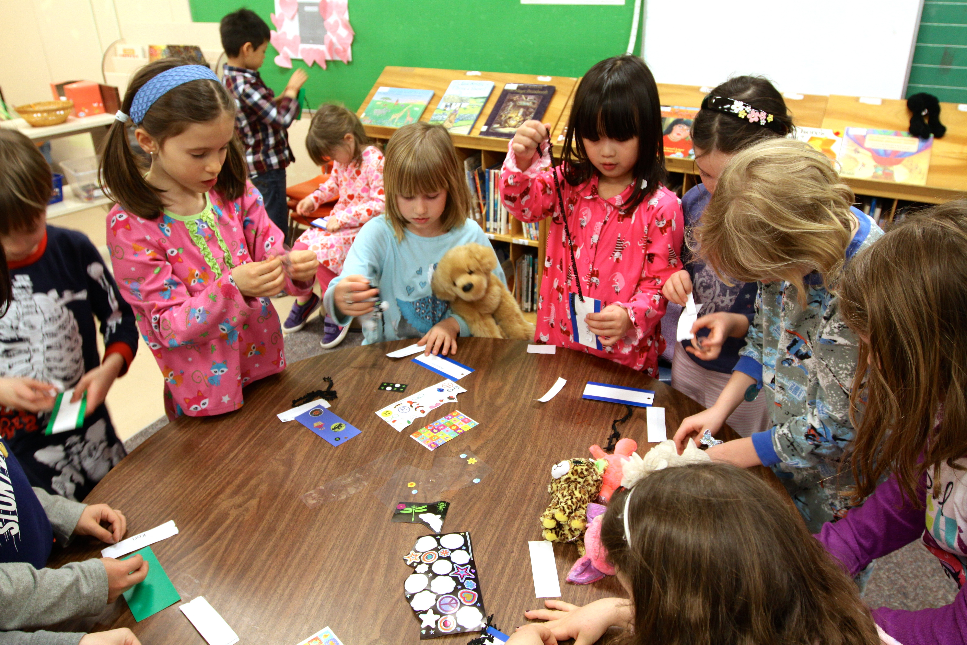

Positive Personal & Cultural Identity
I know who I am and some special things about me.
I can tell you about the people, places, and things
that are important to me.
PS
Personal Awareness
& Responsibility
PS
PS
Personal & Cultural
Social Responsibility
Communication
Critical
C
T
T
Creative

Slide 2
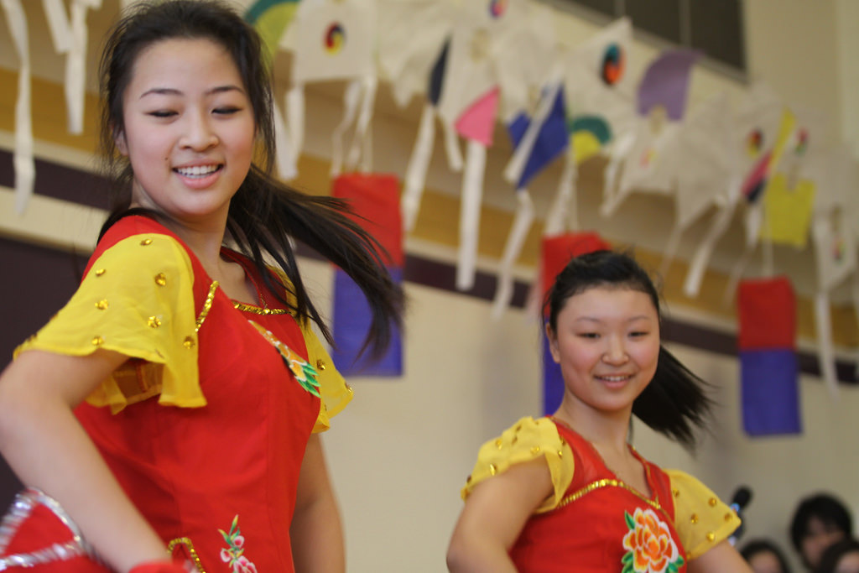
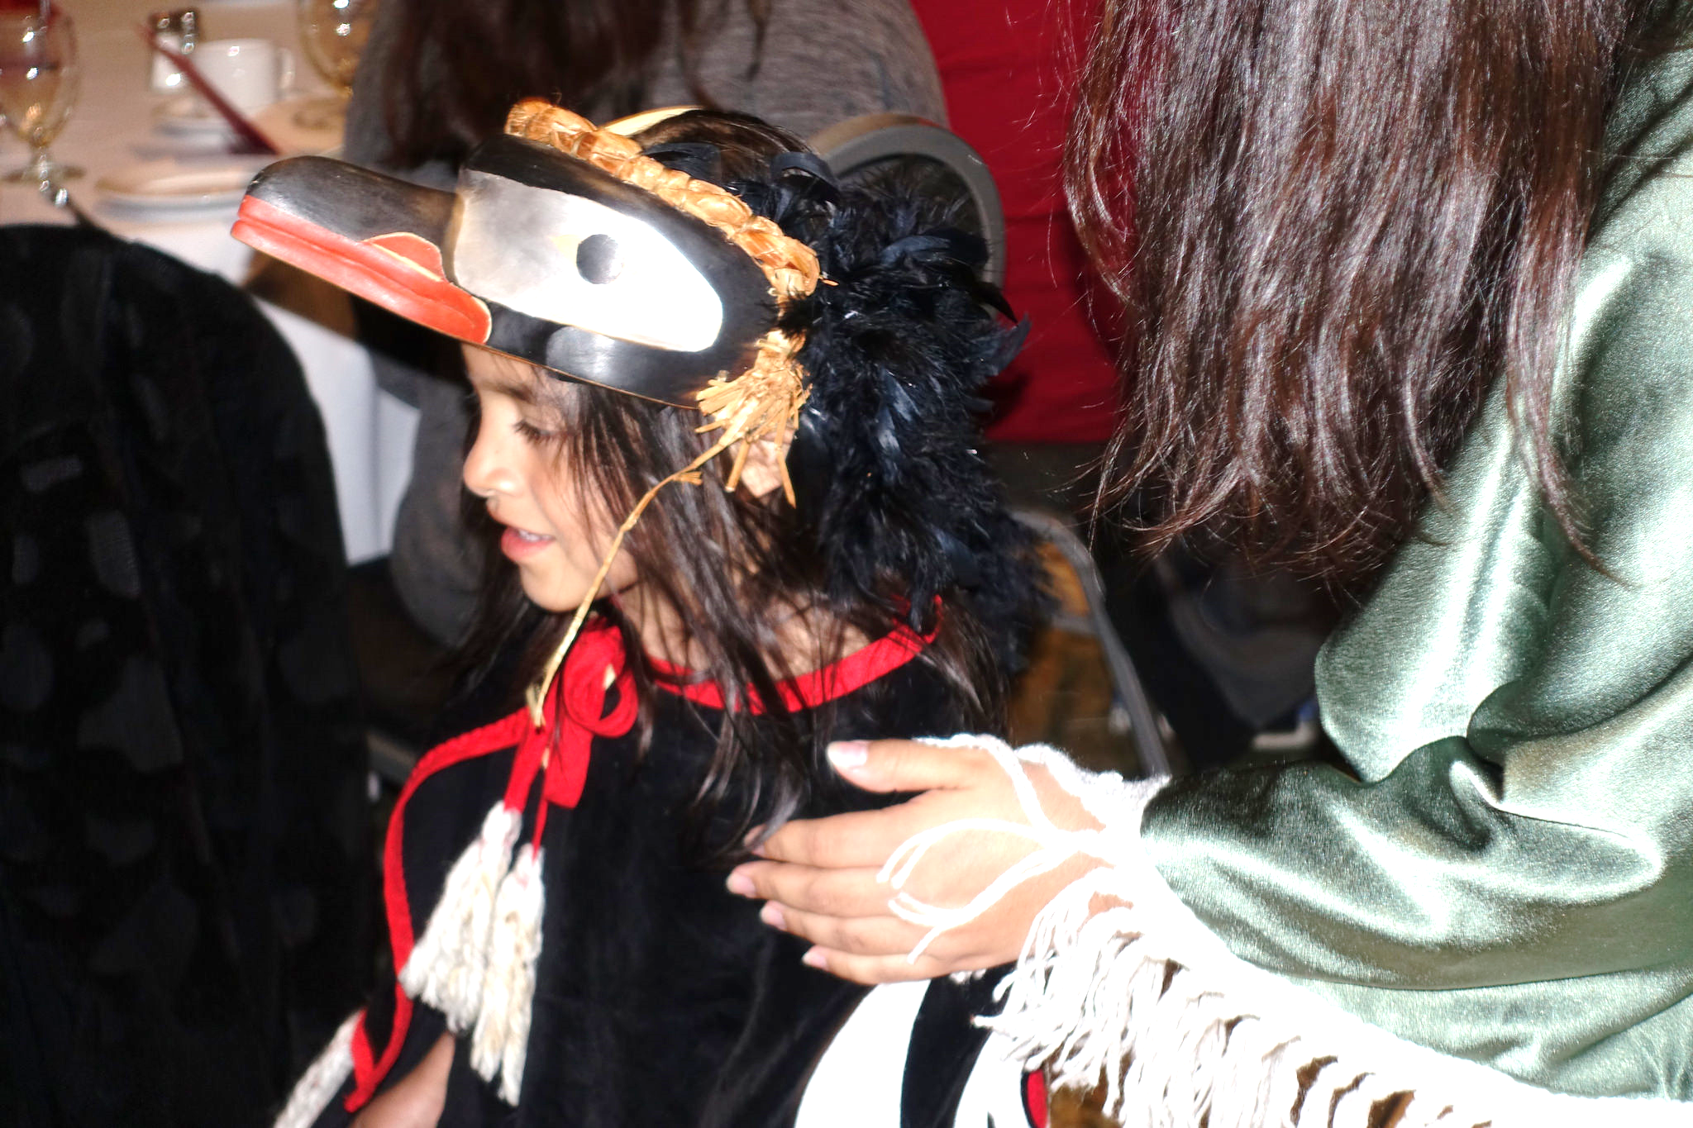
Positive Personal & Cultural Identity
PS
Personal Awareness
& Responsibility
PS
PS
Personal & Cultural
Social Responsibility
Communication
Critical
C
T
T
I know who I am and some
special things about me.
Creative
I can tell you about the people, places, and things that are important to me.

Slide 3
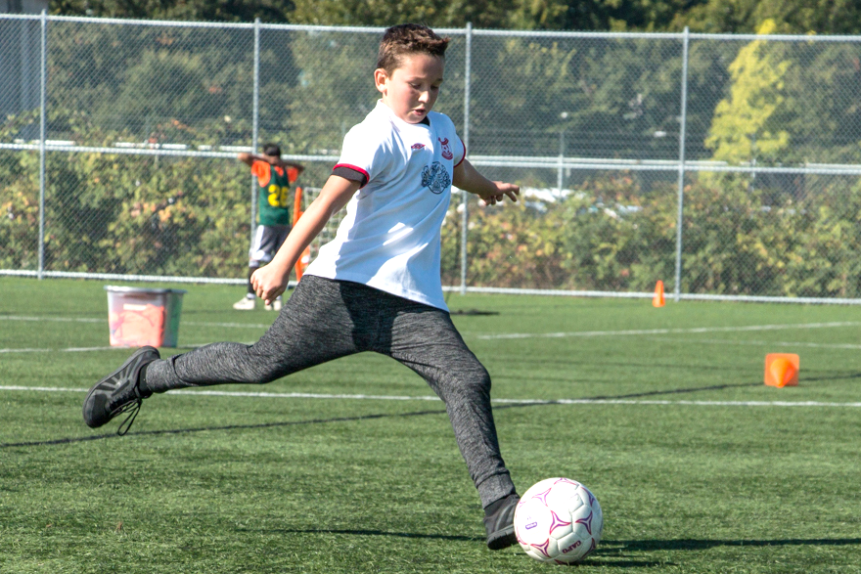
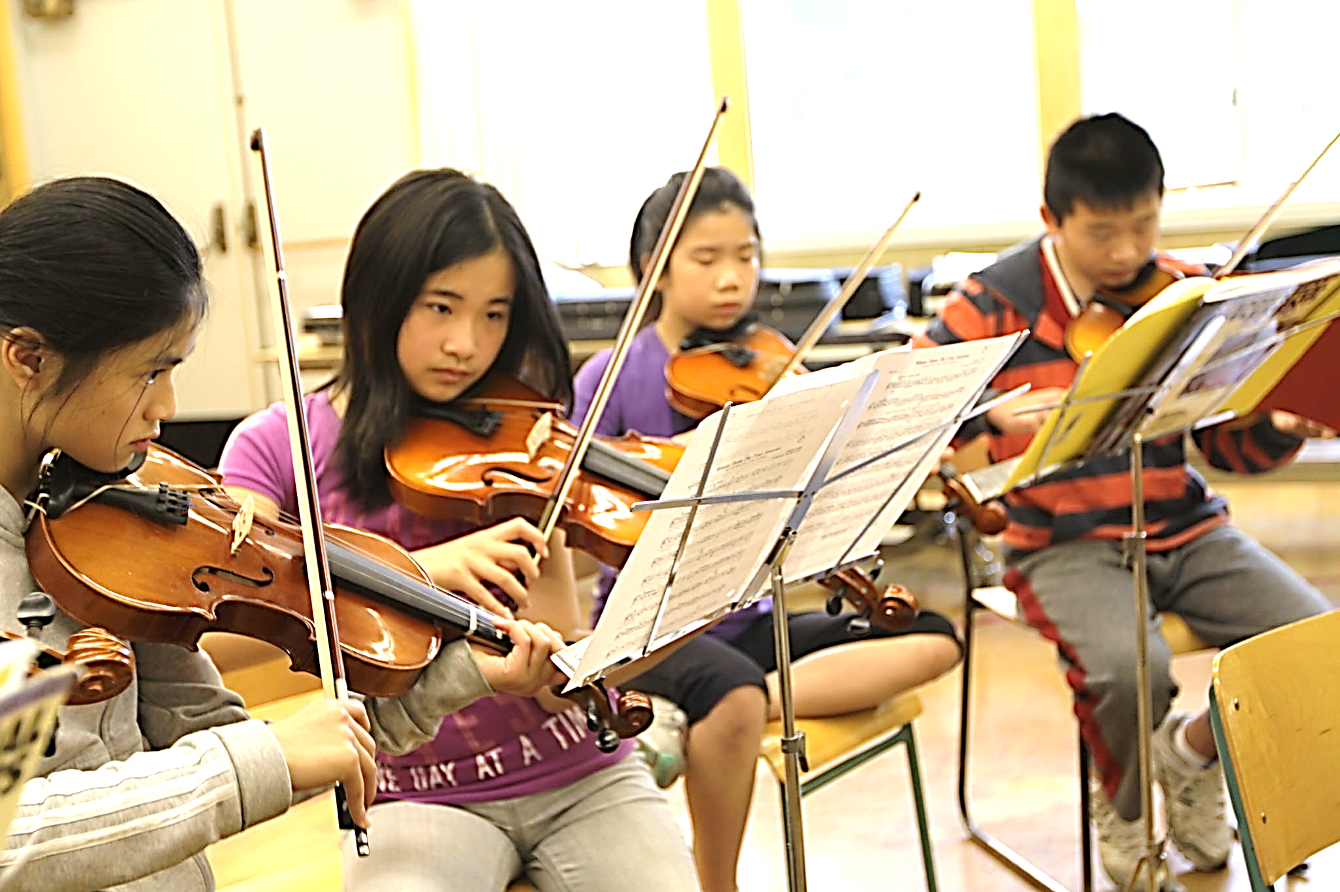
Personal Awareness
& Responsibility
I can set goals for my learning behaviour
Personal Awareness
& Responsibility
PS
I can manage my feelings and emotions
PS
PS
Personal & Cultural
Social Responsibility
Communication
Critical
C
T
T
Creative

Slide 4

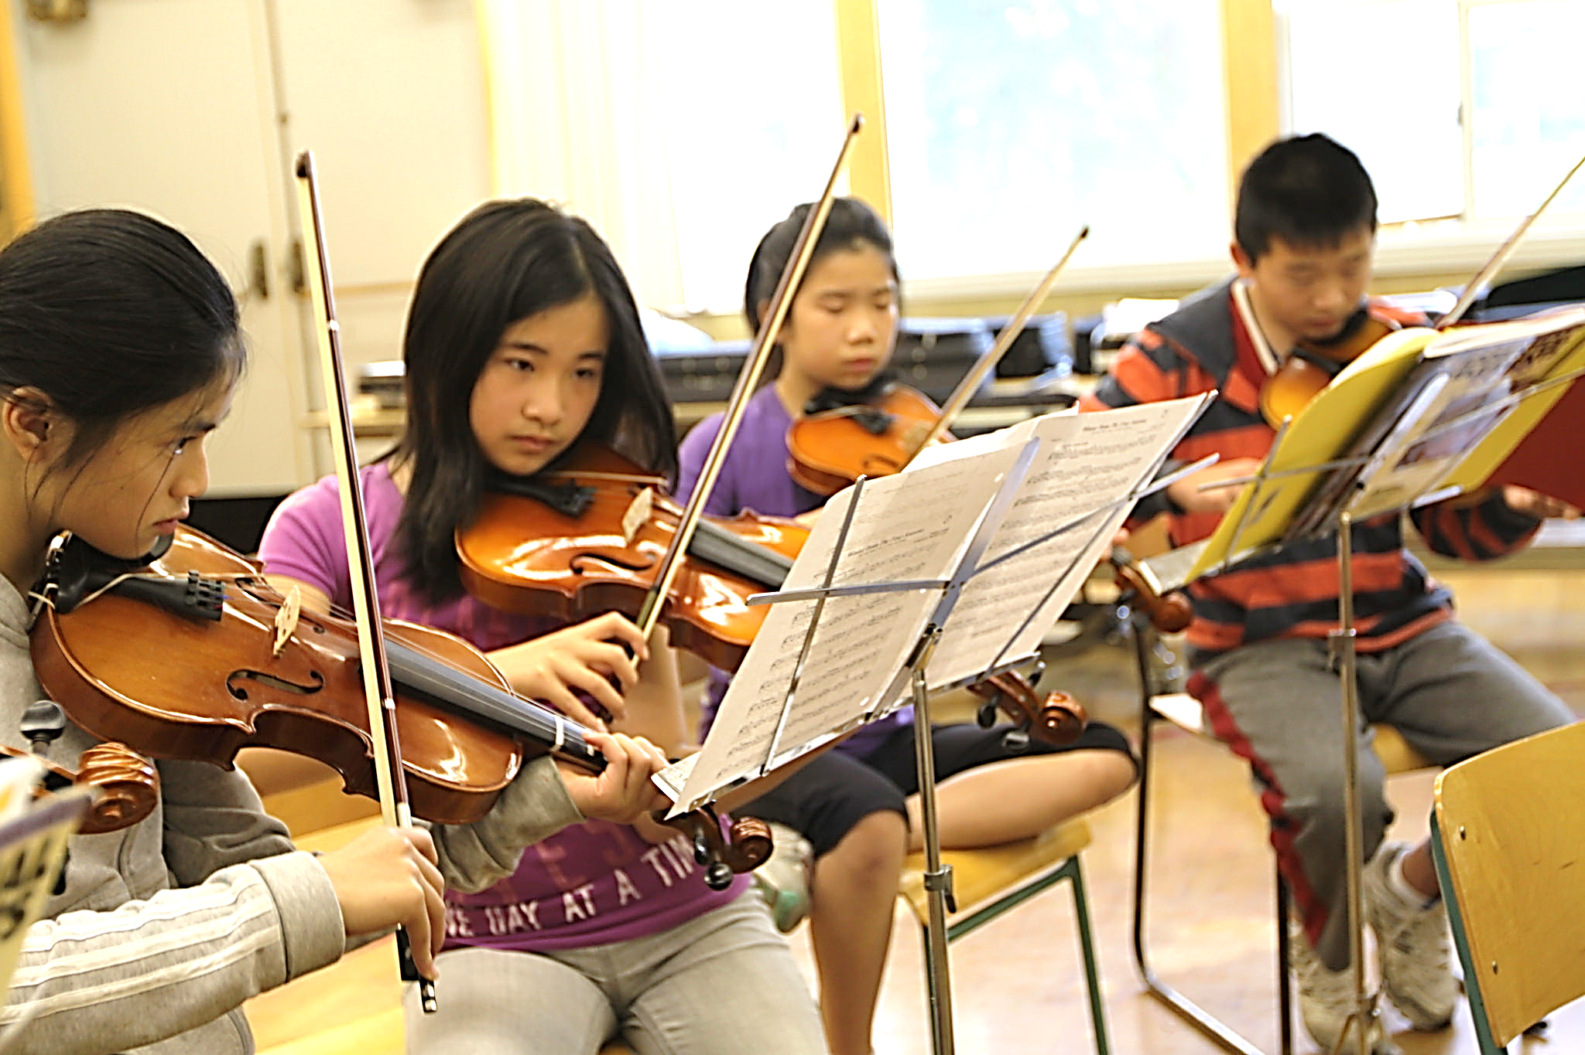
Personal Awareness
& Responsibility
Personal Awareness
& Responsibility
PS
PS
PS
Personal & Cultural
Social Responsibility
Communication
Critical
C
T
I can set goals for my learning behaviour.
T
Creative
I can manage my feelings and emotions.

Slide 5
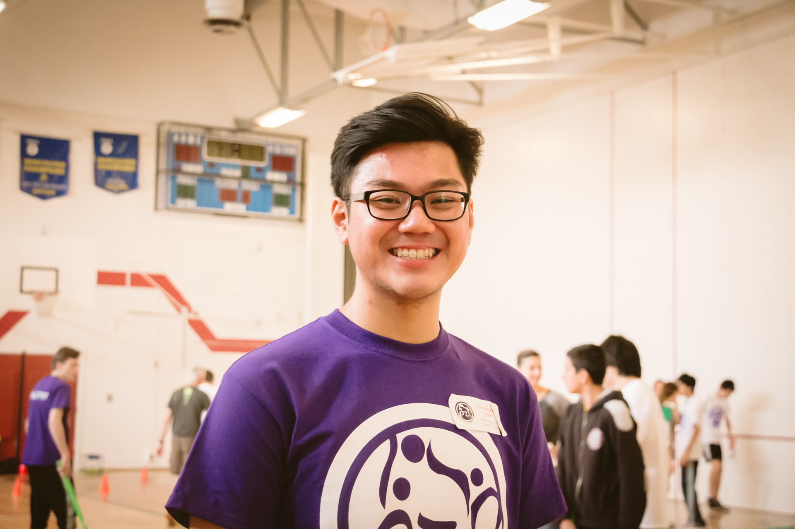
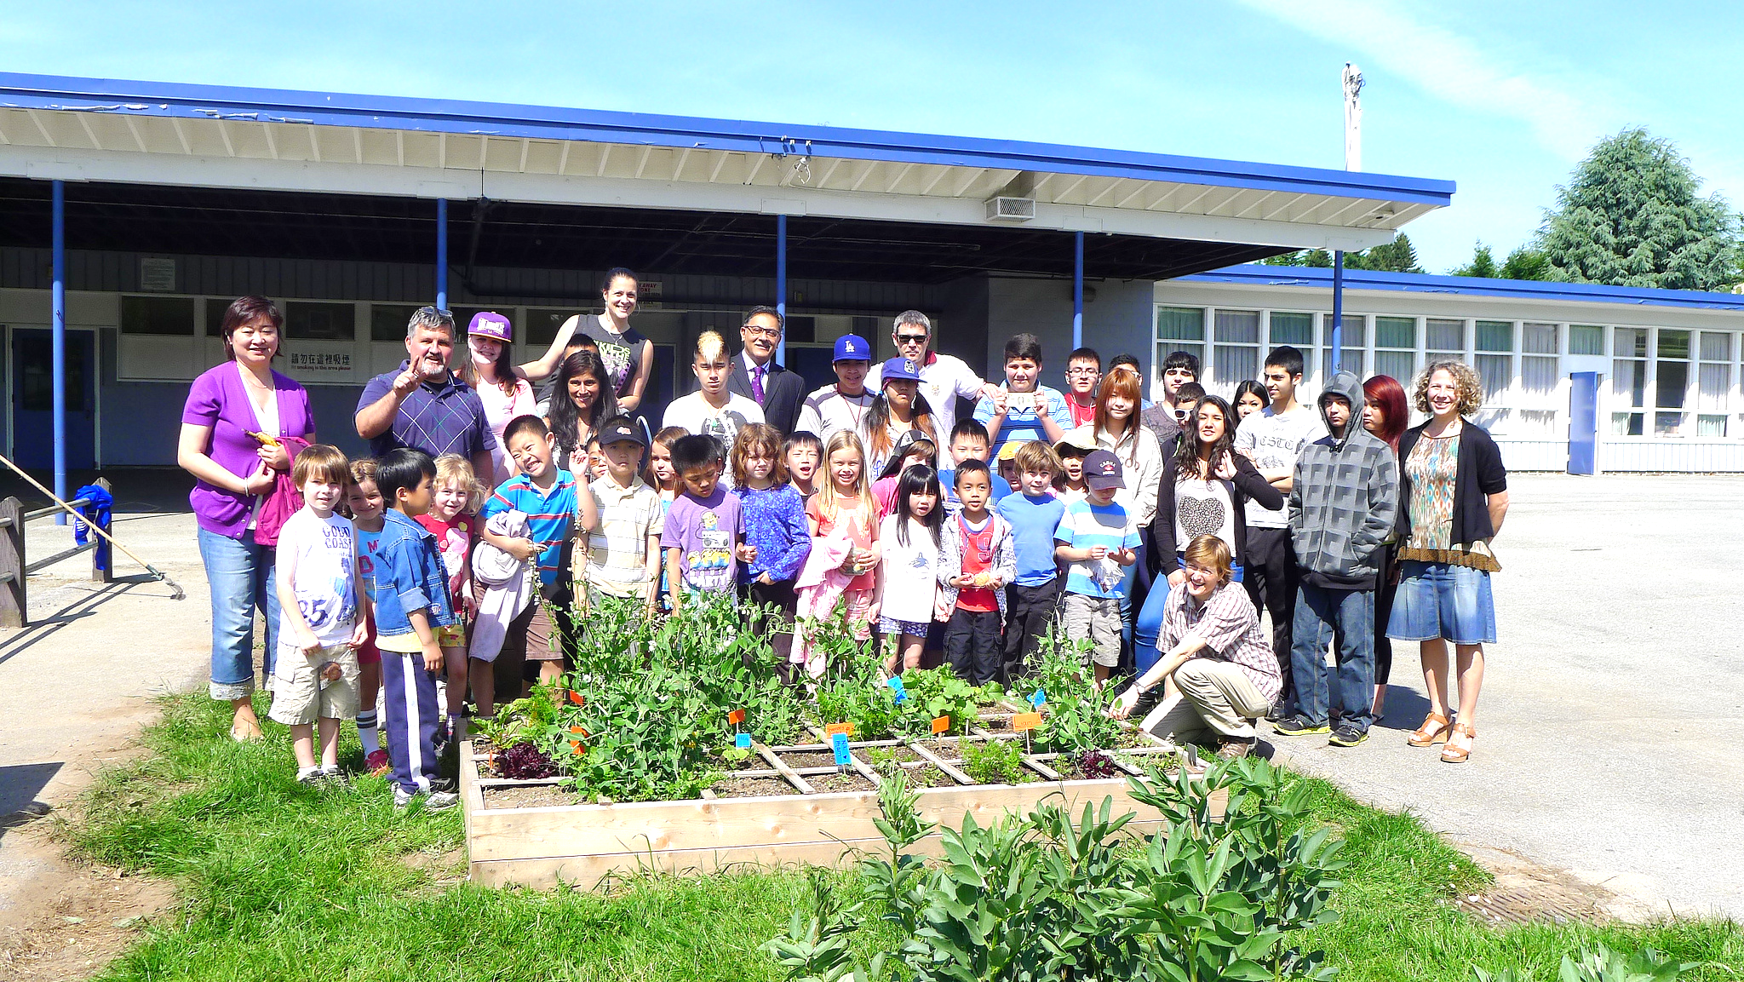
Social Responsibility
I help the school and the environment.
I understand that other people can be different from me.
PS
Personal Awareness
& Responsibility
PS
PS
Social Responsibility
Personal & Cultural
Communication
Critical
C
T
T
Creative

Slide 6
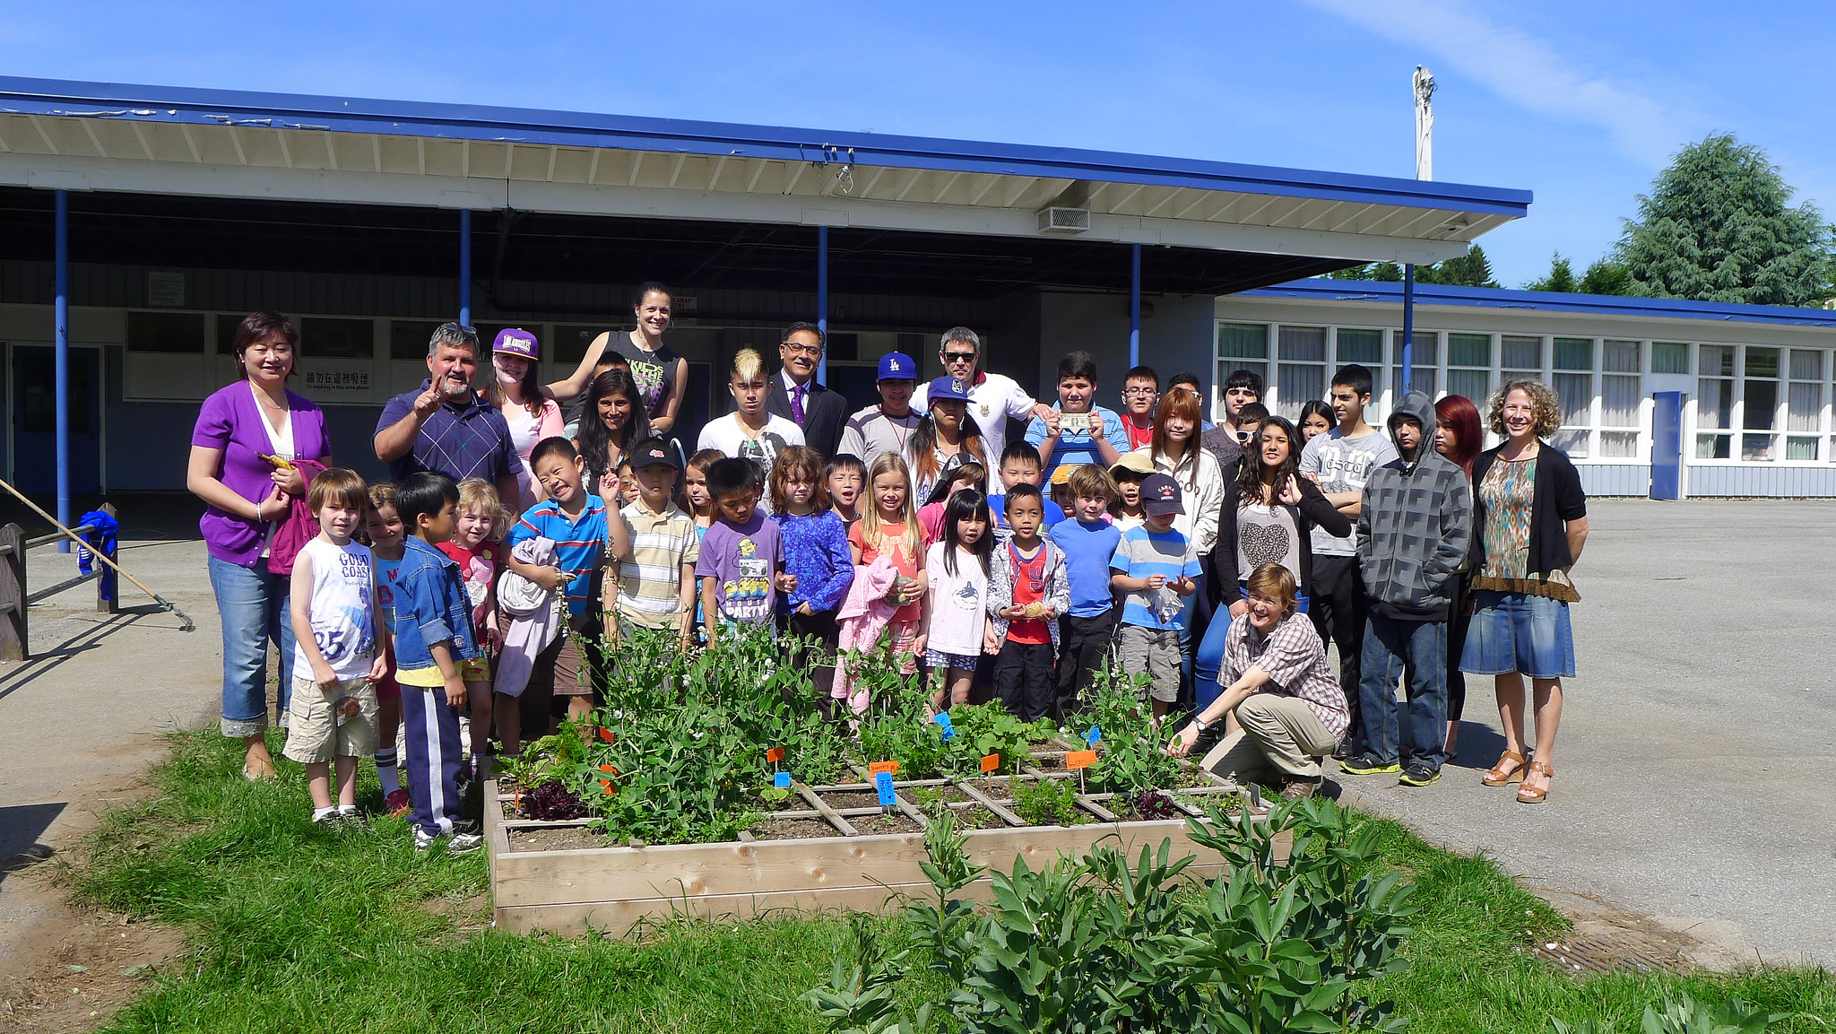
Social Responsibility
PS
Personal Awareness
& Responsibility
PS
PS
Social Responsibility
Personal & Cultural
Communication
Critical
I help the school and the environment.
C
T
T
Creative
I understand that other people can be different from me.

Slide 7
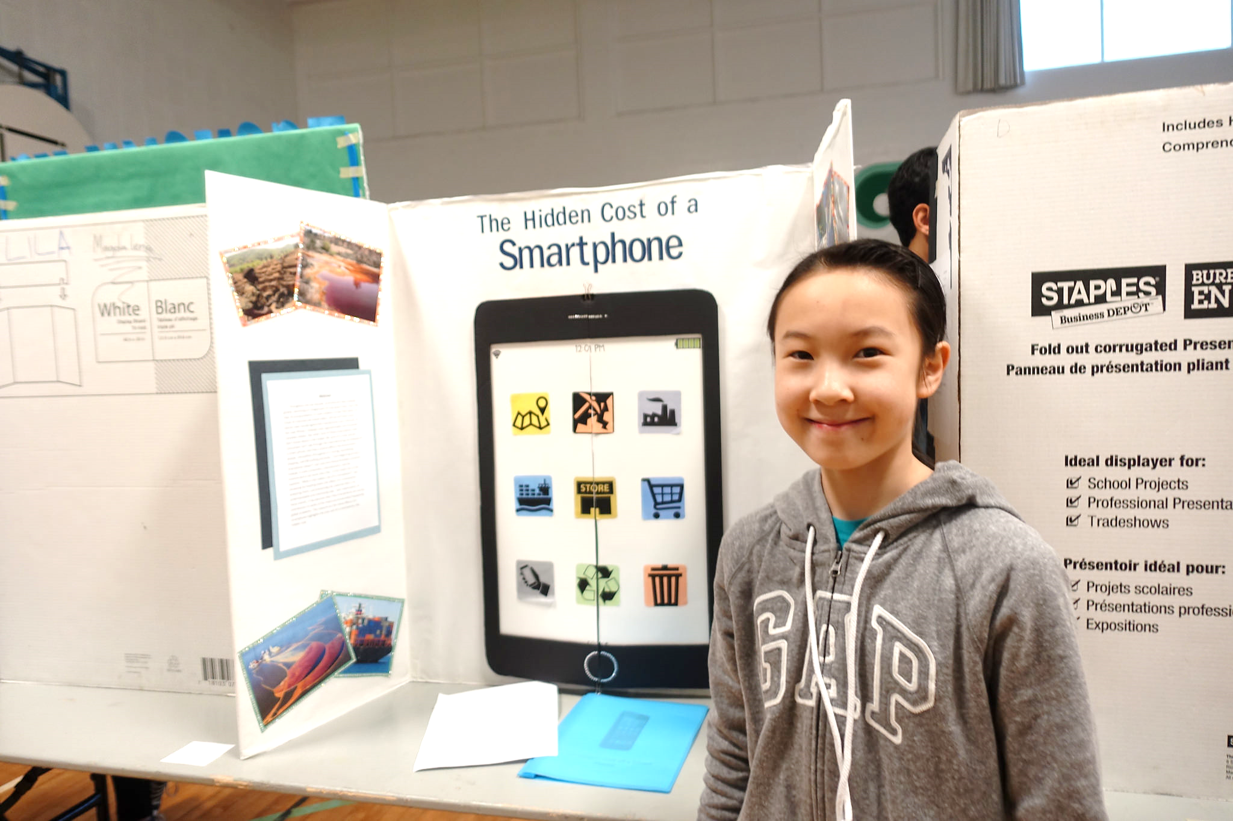
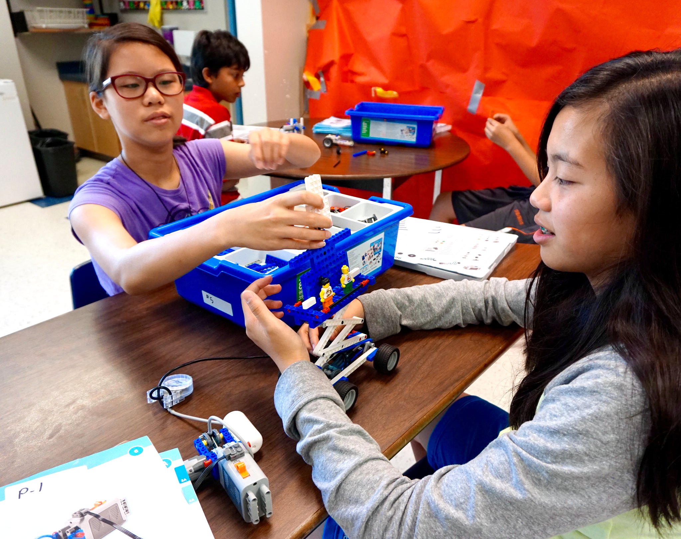
Critical Thinking
I can analyze evidence from different perspectives.
I can ask open-ended questions and gather information.
Personal Awareness
& Responsibility
PS
PS
PS
Personal & Cultural
Social Responsibility
Communication
Critical
C
T
T
Creative

Slide 8
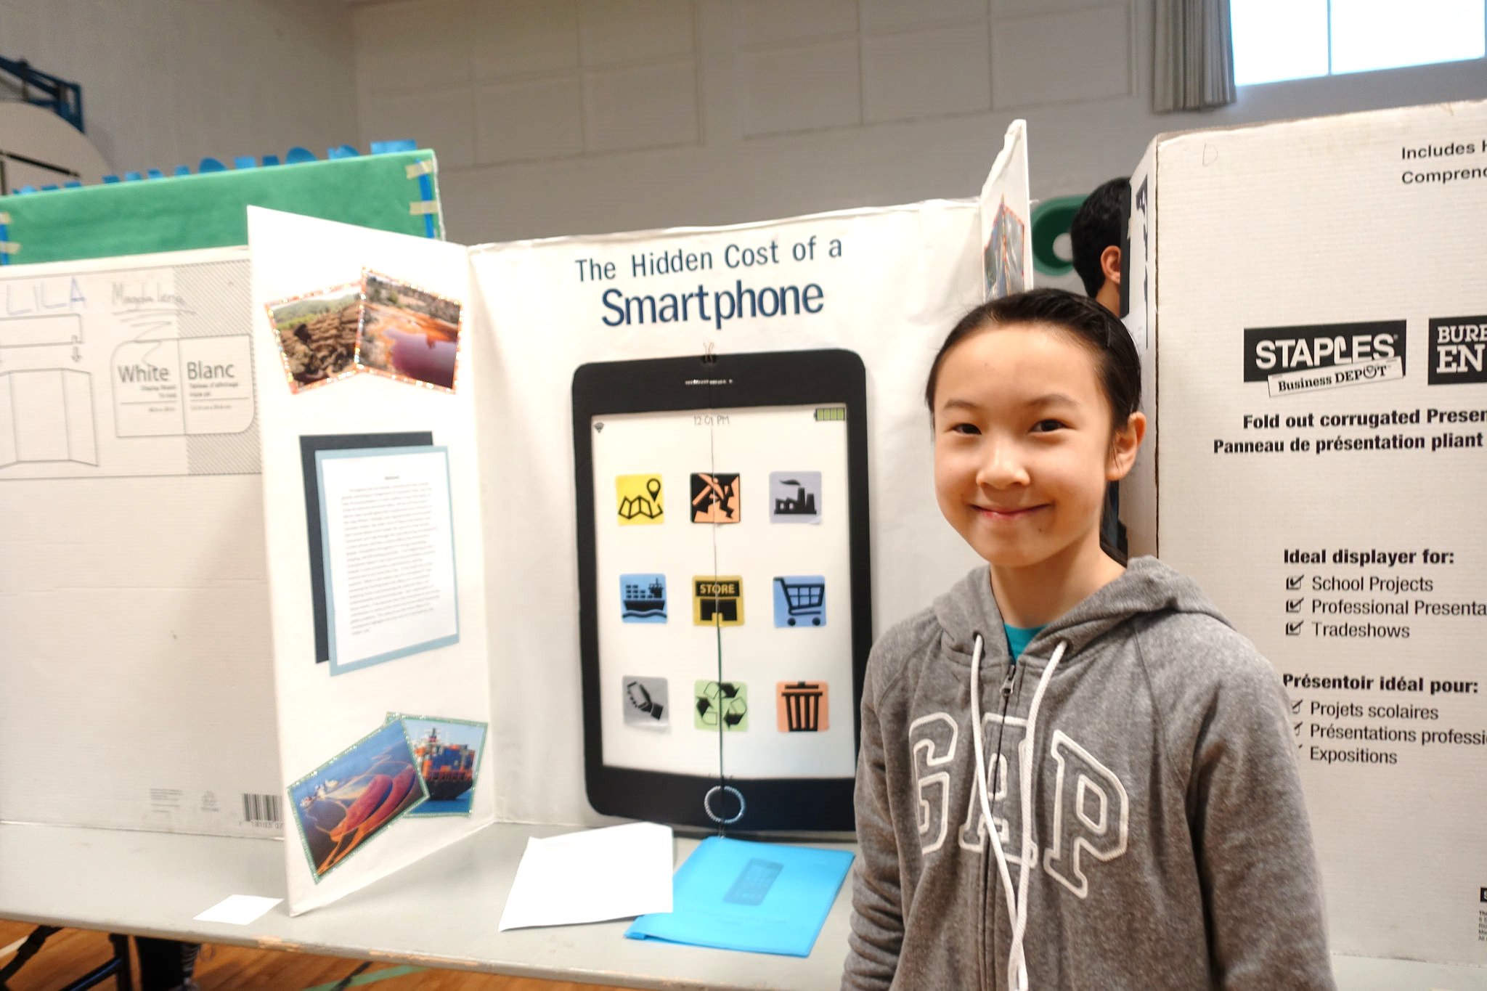
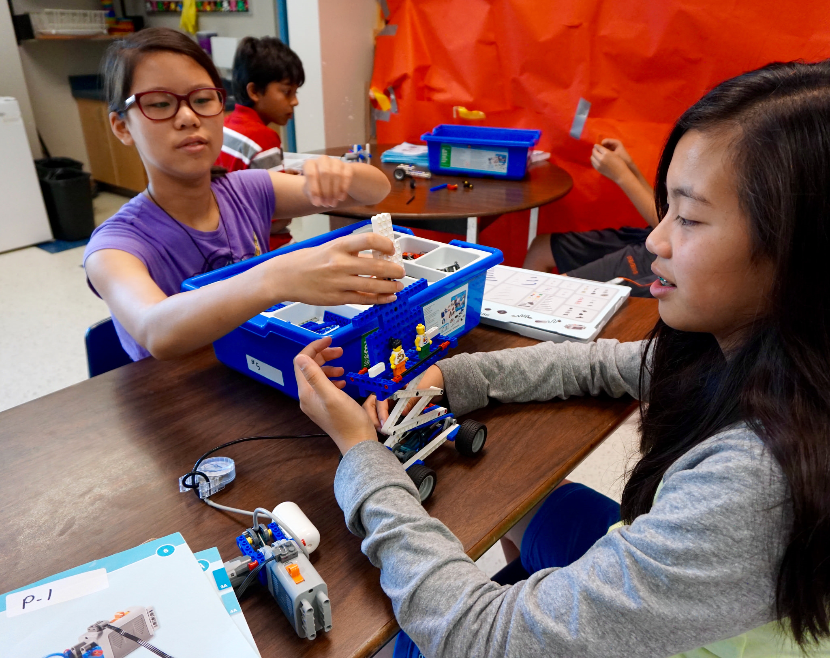
Thinking - Critical
Personal Awareness
& Responsibility
PS
PS
PS
Personal & Cultural
Social Responsibility
Communication
Critical
C
T
T
I can analyze evidence from different perspectives.
Creative
I can ask open-ended questions and gather information.

Slide 9
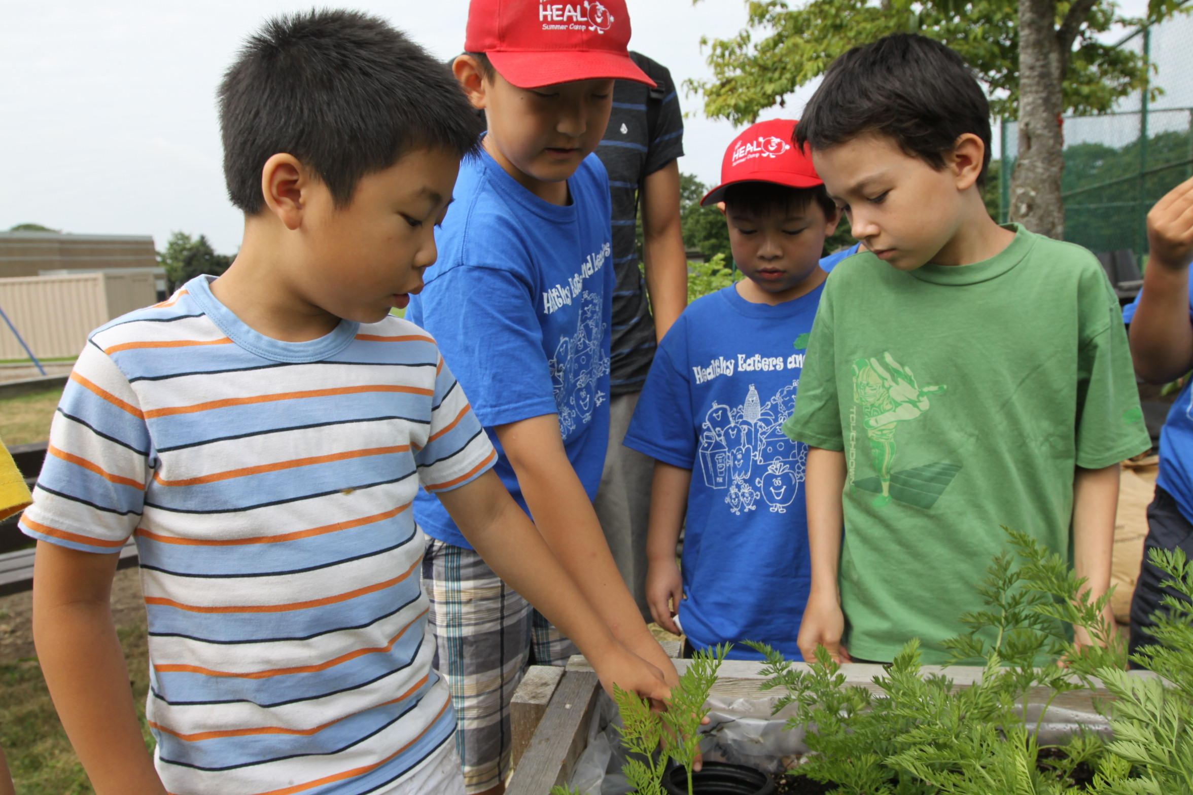
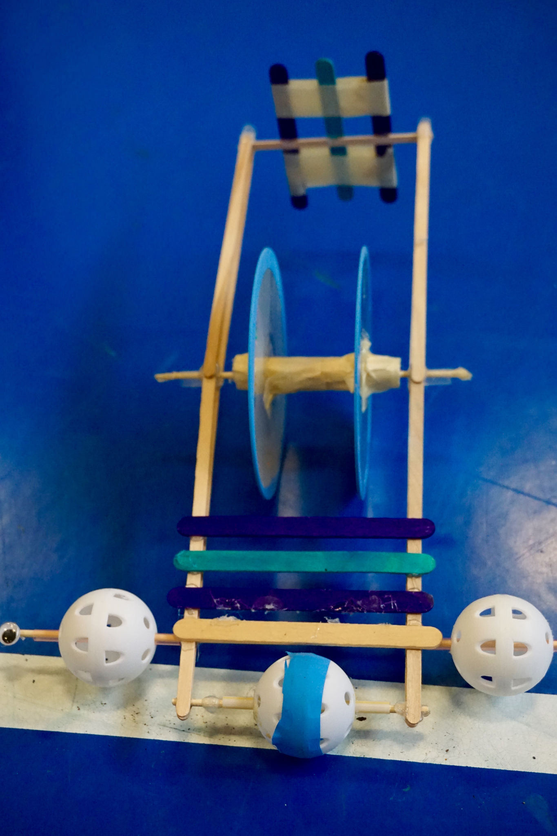
Creative Thinking
I get ideas when I play and explore.
I try a new idea when something doesn’t work.
Personal Awareness
& Responsibility
PS
PS
PS
Personal & Cultural
Social Responsibility
Communication
Critical
C
T
T
Creative

Slide 10
Creative Thinking
Personal Awareness
& Responsibility
PS
PS
PS
Personal & Cultural
Social Responsibility
Communication
Critical
C
T
T
I get ideas when I play and explore.
Creative
I try a new idea when something doesn’t work.

Slide 11
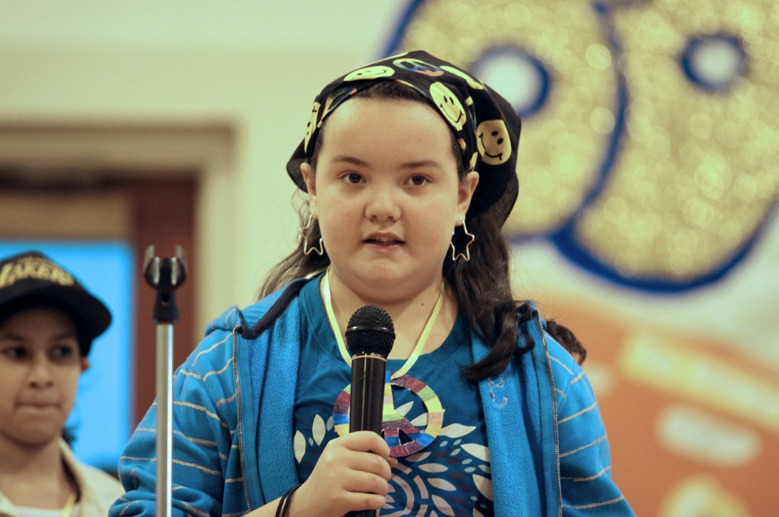
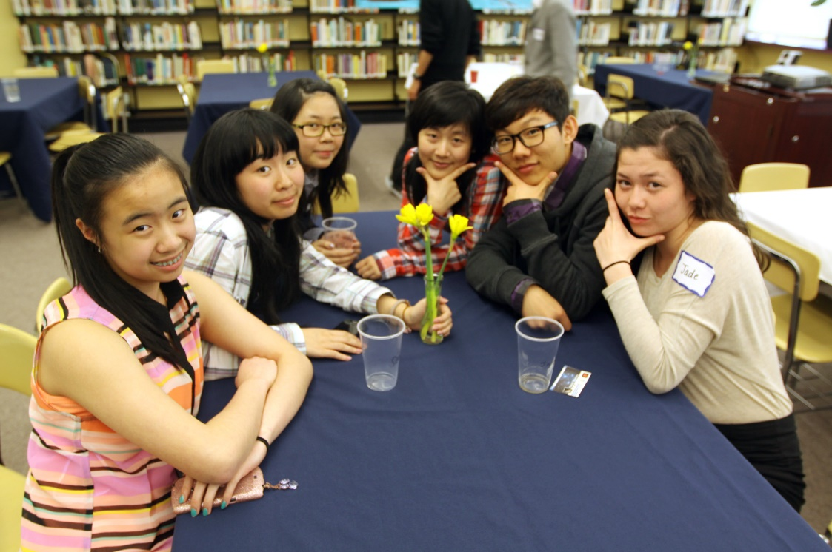
Communication
I can share my ideas and questions.
I can listen to others.
Personal Awareness
& Responsibility
PS
PS
PS
Personal & Cultural
Social Responsibility
Communication
Critical
T
C
T
Creative

Slide 12
Communication
Personal Awareness
& Responsibility
PS
PS
PS
Personal & Cultural
Social Responsibility
Communication
Critical
T
C
T
I can share my ideas and questions.
Creative
I can listen to others.

Slide 13
Personal Awareness
& Responsibility
PS
PS
PS
Personal Awareness
& Responsibility
Personal Awareness
& Responsibility
PS
PS
PS
PS
PS
Social Responsibility
Personal & Cultural
PS
Personal & Cultural
Social Responsibility
Personal & Cultural
Social Responsibility
Communication
Communication
Critical
Communication
C
Critical
C
T
C
Critical
T
T
T
T
Personal Awareness
& Responsibility
T
Creative
PS
PS
PS
Creative
Creative
Personal & Cultural
Social Responsibility
Communication
Critical
C
T
T
Personal Awareness
& Responsibility
Personal Awareness
& Responsibility
PS
PS
Creative
Personal Awareness
& Responsibility
PS
PS
PS
PS
PS
PS
PS
Personal & Cultural
Personal & Cultural
Social Responsibility
Social Responsibility
Communication
Critical
Communication
Critical
Personal & Cultural
Social Responsibility
C
T
C
Communication
Critical
T
T
T
T
C
T
Creative
Creative
Creative

